Slide 2
a)
b)
c)
Readout regime
|↑⇓⟩
|↑⇑⟩
E_{F}
|↓⇓⟩
|↓⇑⟩
Operating regime
|↑⇓⟩
|↑⇑⟩
|↓⇓⟩
N(E)
|↓⇑⟩

Slide 3




a)
$$V_{p}$$
Init
Plunge
Read-out
$$t$$
$$τ$$
b)

Slide 4
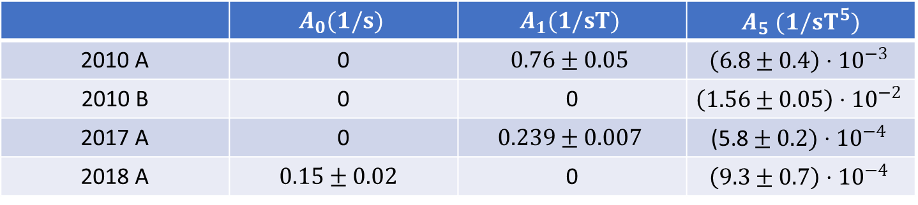

Fit $A_{0}+A_{1}B_{z}+A_{5}B_{z}^{5}$
 | $$A_{0}(1/s)$$ | $$A_{1}(1/sT)$$ | $A_{5}$ $(1/sT^{5})$
2010 A | 0 | $$0.76±0.05$$ | $$\left(6.8±0.4\right)⋅{10}^{−3}$$
2010 B | 0 | 0 | $$\left(1.56±0.05\right)⋅{10}^{−2}$$
2017 A | 0 | $$0.239±0.007$$ | $$\text{(5.8}±0.2)⋅{10}^{−4}$$
2018 A | $$0.15±0.02$$ | 0 | $$\left(9.3±0.7\right)⋅{10}^{−4}$$

Slide 5
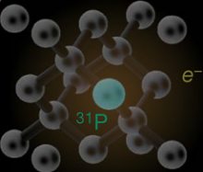
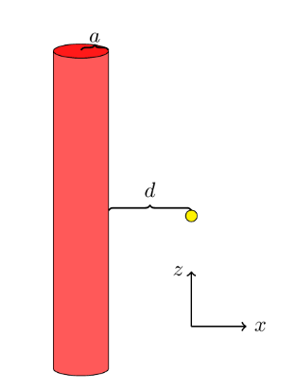
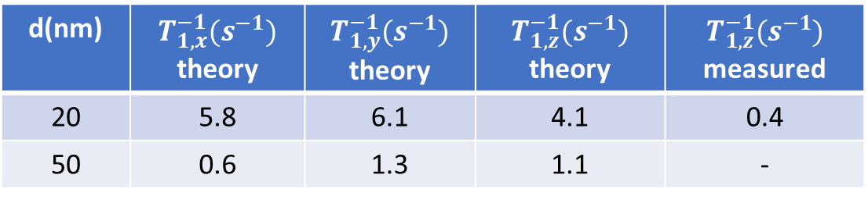
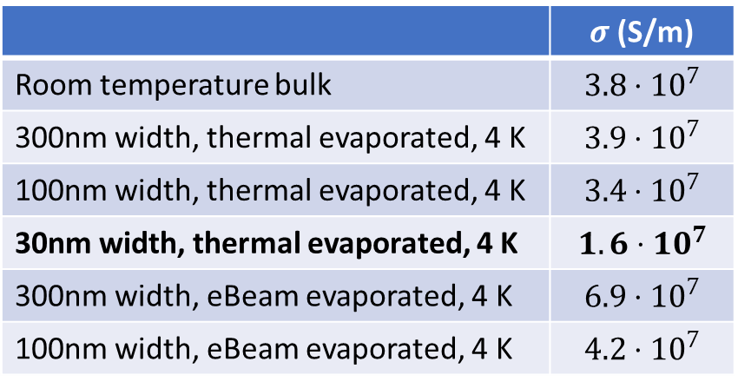
a)
b)
EM wave
metal
dielectric
30nm
Evanescent waves
c)
d)
 | $σ$(S/m)
Room temperature bulk | $$3.8⋅10^{7}$$
300nm width, thermal evaporated, 4 K | $$3.9⋅{10}^{7}$$
100nm width, thermal evaporated, 4 K | $$3.4⋅{10}^{7}$$
30nm width, thermal evaporated, 4 K | $$1.6⋅10^{7}$$
300nm width, eBeam evaporated, 4 K | $$6.9⋅{10}^{7}$$
100nm width, eBeam evaporated, 4 K | $$4.2⋅{10}^{7}$$
e)
d(nm) | $T_{1,x}^{−1}(s^{−1})$ theory | $T_{1,y}^{−1}(s^{−1})$ theory | $T_{1,z}^{−1}(s^{−1})$ theory | $$T_{1,z}^{−1}(s^{−1})$$ measured
20 | 5.8 | 6.1 | 4.1 | 0.4
50 | 0.6 | 1.3 | 1.1 | -

Slide 6
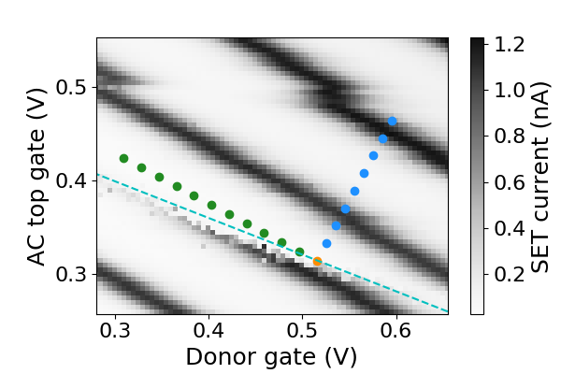
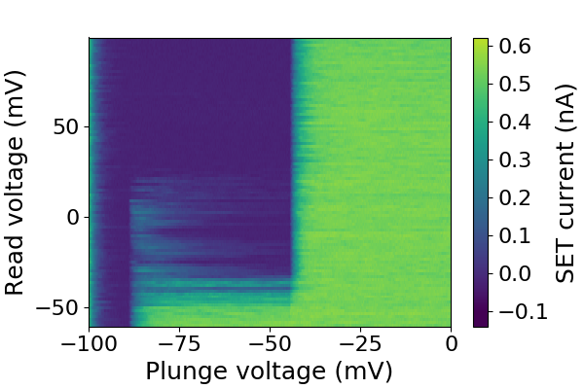

a)
b)
d)
c)
d)
$$\frac{E_{z}}{2}$$

Slide 7
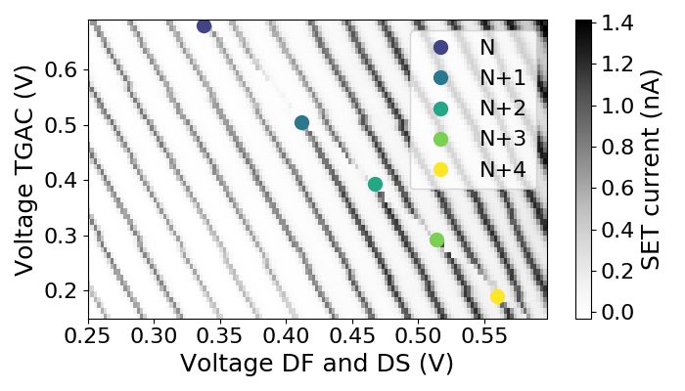
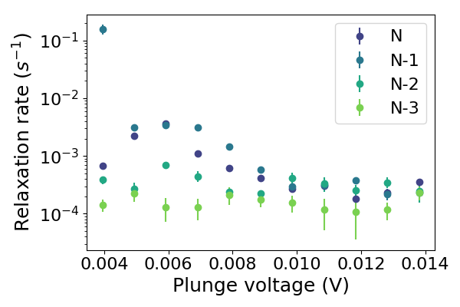

a)
b)
$$\frac{E_{z}}{2}$$

